Slide 1
Medical Field
By: Flora Castro, Daniel Baca, Lyzette Castaneda, Maira Medrano, Nick Waggoner, and Lupe Lira

Slide 2
College and Medical School
Pre-Med Undergraduate Program
becoming a doctor involves completing a four-year pre-med undergraduate program.
The skills necessary to becoming a future doctor are gained during this time period, this college basically prepares you to be successful in passing the MCAT and attending a medical school.
Every medical school would probably have different requirements however overall you would have to focus of the following:
Chemistry
Organic Chemistry
Anatomy
Biology
Physics
Calculus
UC San Diego
UC San Diego is ranked as #17 in Best Medical Schools: Research and #19 in Primary care.
Main Program: Doctor of Medicine (MD)
Relatively Small Medical School: 502 Total Students
Relatively Small First-Year Class: 125 Students
High Undergraduate GPA: 3.82
High MCAT Score: 35 out of 45
Relatively Affordable In-State Tuition: $32,748
Relatively Affordable Out-of-State Tuition: $44,993.

Slide 3
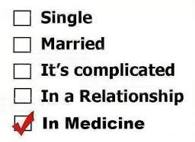
Pre-Med Major
Pre-med is an umbrella term for undergraduate students planning on attending a medical school
Students are likely to enter Medical Schools under majors such as Biology, Chemistry, and Psychology
Pre-Med students are typically prepping themselves for Medical school
High GPAs
Professor Recommendation
Research
Volunteering

Slide 4
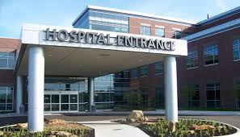
Years of Study
Earn Bachelor’s degree (4 year study)
Take MCAT
MEDICAL COLLEGE ADMISSION TEST
shows your knowledge & skills
Complete medical school (4 year study)
Earn your license
Complete a Residency (Can last 3-8 years)
Mainly at a Hospital
some specializations require fellowship
last up to 3 years

Slide 5
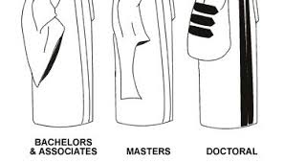
Degrees
Doctorate
Highest level of an academic degree
Takes 4 years to complete, post-bachelor's degree
Will require about 90-12 semester credits
Some programs require a research thesis to be completed.
Masters
Typically takes 1 to 2 years to complete along with an undergraduate degree
Many programs require a thesis or project
Require you to complete 36 to 54 semester credits(or 60 to 90 quarter-credits)
Bachelors
Earned from an undergraduate course of study.
Usually takes 4 years to complete.
Requires that Students choose a major area of study.

Slide 6
Profession
A Doctor is a professional who practices medicine, which is concerned with promoting, maintaining or restoring human health through the study, diagnosis, and treatment of disease.
Many doctors find it rewarding to help improve or save the lives of others.
General Practice doctors in the United States make of an average pay 141k dollars per year and also makes 31k for a bonus.

Slide 7
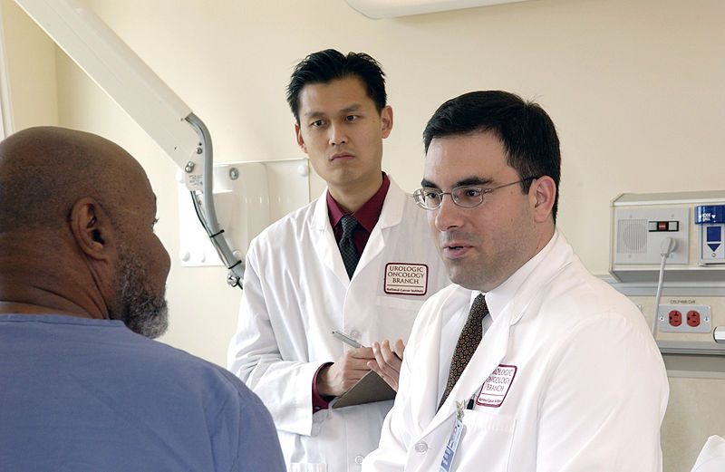
Starting a Clinic
Once we earn our PhD and after years of experience, we could open our own clinic.
Apply for a Federal Grant
Clinic especially for low-income families
Accepts wide variety of insurance
Low prices

